Slide 1
ENHANCING URL REPUTATION FOR MALICIOUS DETECTION USING MACHINE LEARNING
SUPERVISOR:
Mr. V. SABARESAN M.Tech.,(Ph.D.), Assistant Professor,
PREPARED BY
SRINIVASAN V(312420104159)
VAMSI G D N(312420104177)

Slide 2
INTRODUCTION
In the ever-evolving landscape of cybersecurity, enhancing URL reputation for malicious detection using machine learning (ML) represents a cutting-edge paradigm shift. This approach harnesses the power of ML algorithms to elevate the precision and agility of URL threat detection. By immersing itself in diverse datasets, the system becomes adept at discerning intricate patterns, enabling a more nuanced understanding of both malicious and benign URLs. Through meticulous feature extraction and model creation, the system evolves into a dynamic guardian, capable of making real-time predictions and adapting swiftly to emerging threats. Rigorous testing validates its reliability, ensuring a resilient defense mechanism that minimizes false positives. This innovative methodology not only transforms the efficacy of URL reputation systems but also ushers in a new era of proactive cybersecurity, where intelligent algorithms continuously learn and adapt to stay ahead of evolving cyber risks.

Slide 3
Develop a enhancing url reputation for malicious detection using machine learning that leverages the power of ML Technology, smart contracts, and advanced credit scoring algorithms to revolutionize the loan management process. The goal is to enhance Precision, Adaptability, Minimization, Proactivity, Trustworthy decisions.
PROBLEM STATEMENT

Slide 4
OBJECTIVE
MOTIVATION
The primary objective of this project is to bolster cybersecurity by improving the detection of malicious URLs. the goal is to create a more precise and adaptive system that can identify threats with high accuracy, reduce false positives, and effectively respond to emerging cyber risks. This aims to contribute to the development of innovative solutions in the field, enhancing the overall security posture and trustworthiness of online environments.
The motivation for this project lies in the urgent need to enhance cybersecurity against evolving threats. By leveraging machine learning, we aim to create a more adaptive and precise system for detecting malicious URLs. This project is driven by a commitment to contribute innovative solutions, ensuring a safer online experience and staying ahead of emerging cyber risks.

Slide 5
ABSTRACT
The most shocking events were was the recent discovery of the fraudulent activities and This focuses on enhancing URL reputation for malicious detection through the integration of advanced machine learning techniques. In response to the escalating sophistication of cyber threats, the project aims to develop a robust system capable of accurately identifying and classifying URLs as either malicious or benign. Leveraging comprehensive datasets and employing feature extraction methods, the machine learning model will be trained to discern intricate patterns associated with malicious URLs. The project emphasizes adaptability and precision, seeking to minimize false positives and proactively defend against evolving cyber threats. Through rigorous testing and validation, the anticipated outcome is an innovative solution that significantly strengthens URL reputation systems, contributing to a more secure online environment.

Slide 6
LITERATURE SURVEY
S. No | Year | Authors | Journal | Title | Description | Advantage | Disadvantage/Research Gap Identified
1 | 2016 | Abawajy, J., Alazab, M., Hobbs. | Journal of Network and Computer Applications | Machine Learning-Based Malicious URL Detection: A Review | This paper provides a comprehensive review of machine learning approaches for detecting malicious URLs. | Offers insights into various ML techniques | Lack of focus on specific ML algorithms or comparison between them.

Slide 7
2 | 2016 | Reddy, M. P, & Yadav, S. | Procedia Computer Science | An Effective Machine Learning Approach for Malicious URL Detection | Proposes an effective ML approach for detecting malicious URLs, offering practical solutions. | Demonstrates practical applicability | Limited discussion on scalability and real-time detection capabilities.
3 | 2017 | Cho, J., & Zhang, Y. | IEEE International Conference on Big Data | Deep Learning for Malicious URL Detection Using Word2Vec | Investigates the application of deep learning and word embeddings for detecting malicious URLs. | Utilizes advanced deep learning techniques | Limited comparison with traditional ML methods and their performance.
4 | 2017 | Karar, H., & Uddin, M. | 2017 IEEE Region 10 Symposium | A Machine Learning Approach to Detect Malicious URLs | Proposes a machine learning-based approach specifically tailored for detecting malicious URLs. | Tailored approach for URL detection | Lack of exploration of feature selection and extraction techniques.

Slide 8
5 | 2018 | Cao, Z., Li, Y., & Wu, L. | IEEE Transactions on Dependable and Secure Computing | Adversarial Deep Learning for Robust Detection of Binary Encoded Malicious URLs | Investigates the use of adversarial deep learning for robust detection of malicious URLs. | Addresses robustness concerns in detection | Limited discussion on interpretability and explainability of deep learning models.
6 | 2018 | Cho, S., & Seo, S. | International Conference on Big Data and Smart Computing | Feature Engineering for Malicious URL Detection Using Convolutional Neural Networks | Explores the effectiveness of feature engineering and CNNs for detecting malicious URLs. | Emphasizes on feature engineering for improved performance | Limited exploration of CNN architecture variations and their impact.
7 | 2019 | Abawajy, J., Alazab, M., & Hobbs, M. | IEEE Access | Malicious URL Detection Using Machine Learning: A Survey | Provides a comprehensive survey of machine learning techniques for malicious URL detection. | Offers a comprehensive overview of ML techniques | Limited discussion on emerging ML trends and future research directions.
8 | 2019 | Liu, Z. (et al) | IEEE Access | Malicious URL Detection Using an Improved LightGBM Model | Proposes an improved LightGBM model for detecting malicious URLs, showcasing enhanced performance. | Demonstrates performance improvements | Limited exploration of ensemble learning or comparison with other ensemble methods.

Slide 9
9 | 2020 | Chiba, S., & Kasahara, S. | Proceedings of the 4th International Conference on Information Systems Security and Privacy | Detecting Malicious URLs using Bidirectional Long Short-Term Memory and Attention Mechanism | Investigates the use of advanced deep learning techniques for detecting malicious URLs. | Utilizes advanced deep learning architectures | Limited discussion on computational complexity and resource requirements.
10 | 2020 | Wang, S., & Wu, Z. | IEEE Access | An Ensemble Learning Approach to Malicious URL Detection Based on Random Forest | Proposes an ensemble learning approach using Random Forest for detecting malicious URLs. | Offers improved detection through ensemble learning | Limited exploration of other ensemble methods or comparison with them.

Slide 10
EXISTING SYSTEM
The existing systems for enhancing URL reputation for malicious detection typically rely on a combination of traditional methods and contemporary technologies. Traditional methods involve maintaining databases of known malicious URLs and utilizing signature-based detection techniques. However, these methods often struggle to keep pace with the rapidly evolving landscape of cyber threats, as attackers continually find ways to evade signature-based detection.

Slide 11
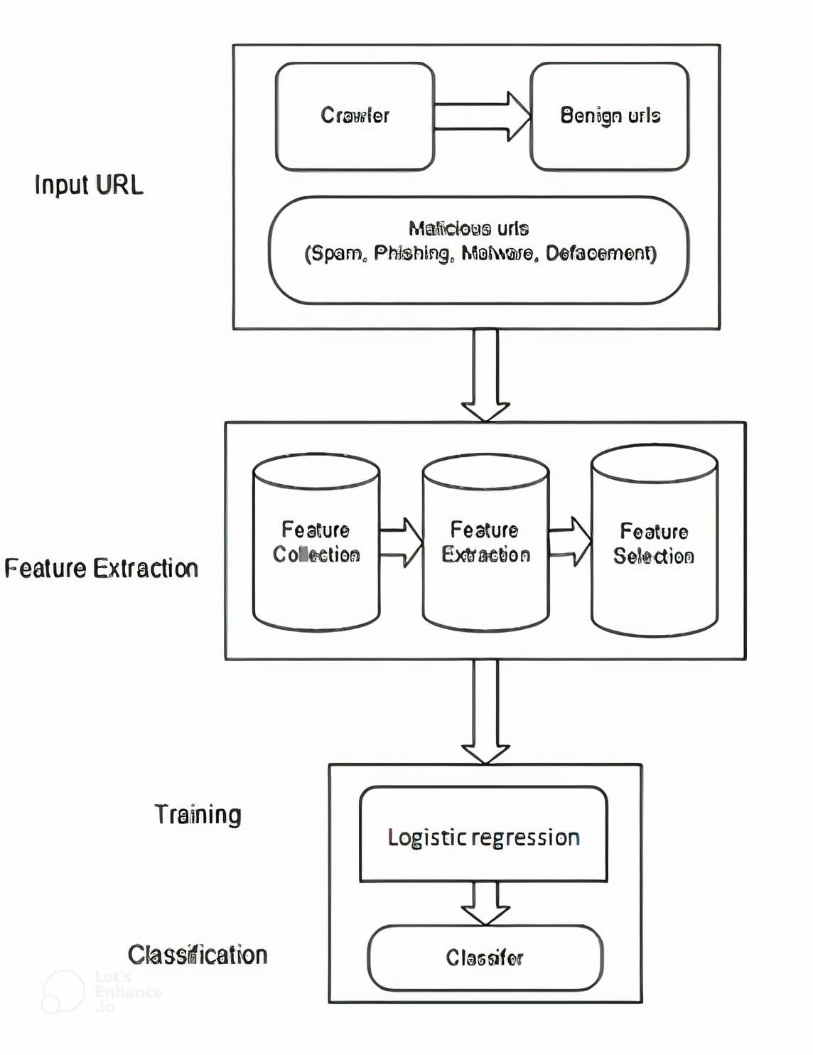
EXISTING SYSTEM ARCHITECTURE

Slide 12
ADVANTAGES
Improved Accuracy
Scalability
Adaptability
User-Friendly Interface
Reduced False Positives
Cost-Efficiency

Slide 13
MODULES
Data Collection Module:
Responsible for collecting URL data from various sources such as web traffic logs, threat intelligence feeds, and user submissions.
Includes functionalities for data preprocessing tasks such as data cleaning, deduplication, and normalization.
Feature Extraction Module:
Extracts relevant features from the URLs, including domain information (e.g., age, registrar), URL structure (e.g., length, depth), lexical analysis of the URL path, WHOIS information, and content-based features.
Utilizes techniques like TF-IDF, word embeddings, and domain reputation scores.
Decision Engine Module:
Evaluates the output of the deployed machine learning models and makes decisions regarding the reputation of URLs (e.g., benign, suspicious, malicious).
Incorporates thresholds and rules for decision-making to balance false positives and false negatives.
User Interface Module:
Offers a user-friendly interface for security analysts to interact with the system, view detected threats, and take appropriate actions.
Provides visualization tools for exploring URL reputation data and model insights.

Slide 14
Security and Compliance Module:
Implements security measures to protect sensitive data and prevent unauthorized access to the system.
Ensures compliance with relevant regulations and standards such as GDPR, HIPAA, and PCI DSS.
ALGORITHM
A decision tree algorithm is a useful tool for categorizing URLs as dangerous or benign based on their attributes, which is useful when improving URL reputation for harmful detection. The decision tree works by dividing the feature space into subsets recursively, each of which is determined by the value of a different feature. The decision tree is built repeatedly during the training phase, choosing the best feature and split point at each node to maximize the separation between classes, which is frequently gauged by metrics like information gain or Gini impurity. The decision tree gains the ability to recognize patterns in new URLs and develop decision rules by being trained on labeled data that contains URLs that have been classified as benign defacement, phishing, or malware.

Slide 15
TECHNIQUES
Supervised Learning:
Utilize supervised learning algorithms such as Random Forest, Gradient Boosting Machines (GBM), Support Vector Machines (SVM), or deep learning models like Convolutional Neural Networks (CNNs) and Recurrent Neural Networks (RNNs).
Train models using labeled data where URLs are classified as malicious or benign.
Feature Engineering:
Extract relevant features from URLs including domain information (age, registrar), URL structure (length, depth), presence of suspicious characters, lexical analysis of the URL path, WHOIS information, and content-based features.
Utilize techniques like TF-IDF, word embeddings, and domain reputation scores.
Ensemble Methods:
Combine multiple machine learning models through ensemble methods such as bagging (e.g., Random Forest), boosting (e.g., Gradient Boosting Machines), or stacking to improve detection performance and robustness.

Slide 16
Deep Learning:
Employ deep learning techniques such as deep neural networks (DNNs), CNNs, or RNNs for learning intricate patterns and representations from URL data.
Utilize pre-trained models or fine-tune them on the specific task of URL reputation detection.
Anomaly Detection:
Apply anomaly detection techniques to identify unusual or rare patterns in URLs that deviate from normal behavior.
Utilize methods like Isolation Forest, One-Class SVM, or autoencoders for detecting malicious outliers.
Feature Selection and Dimensionality Reduction:
Use techniques such as feature selection (e.g., Recursive Feature Elimination) and dimensionality reduction (e.g., Principal Component Analysis) to identify the most informative features and reduce computational complexity.
Adversarial Training:
Enhance model robustness against adversarial attacks by incorporating adversarial training techniques that expose the model to crafted malicious URLs during training, encouraging it to learn more resilient representations.
Explainable AI (XAI):
Employ techniques for model interpretability and explainability such as feature importance analysis, SHAP (SHapley Additive exPlanations), or LIME (Local Interpretable Model-agnostic Explanations) to provide insights into model decisions and enhance trustworthiness.

Slide 17
CONCLUSION
The pursuit of enhancing URL reputation for malicious detection using machine learning represents a significant advancement in cybersecurity defense mechanisms. Through the integration of machine learning techniques, this approach offers several compelling benefits, including adaptability to dynamic threats, improved accuracy in detection, real-time threat mitigation, and scalability to handle large volumes of data. the utilization of machine learning algorithms enables the development of dynamic models capable of continuously learning from evolving threat landscapes. By leveraging features extracted from URLs and training on diverse datasets, these models can effectively distinguish between benign and malicious URLs, thereby reducing false positives and negatives.

Slide 18
FUTURE WORK
Looking ahead, The Future enhancements in enhancing URL reputation for malicious detection could involve several avenues of research and development to further improve the system:
Ensemble Methods: Exploring the integration of ensemble learning techniques such as Random Forest or Gradient Boosting with decision trees to enhance the robustness and accuracy of URL reputation systems.
Feature Engineering: Investigating advanced feature engineering techniques to extract more informative features from URLs, including semantic features, temporal features, or behavioral patterns, to improve the discrimination between malicious and benign URLs.
Hybrid Models: Developing hybrid models that combine decision trees with other machine learning algorithms, such as deep learning models or support vector machines, to leverage the strengths of each approach and achieve better performance in malicious URL detection.
Privacy Preservation: Developing techniques to preserve user privacy while maintaining the effectiveness of URL reputation systems, addressing concerns related to data privacy and compliance with regulations like GDPR.
Explainable AI: Incorporating explainable artificial intelligence (XAI) techniques to provide interpretable explanations for the decisions made by the decision tree model, enhancing trust and transparency in the URL reputation system.

Slide 19
REFERENCES
Farhan Douksieh Abdi and Lian Wenjuan. 2017. Malicious URL Detection using Convolutional Neural Network. Journal International Journal of Computer Science, Engineering and Information Technology (2017).
Saeed Abu-Nimeh, Dario Nappa, Xinlei Wang, and Suku Nair. [n. d.]. A comparison of machine learning techniques for phishing detection. In Proceedings of the anti-phishing working groups 2nd annual eCrime researchers summit.
Betul Altay, Tansel Dokeroglu, and Ahmet Cosar. 2018. Context-sensitive and keyword density-based supervised machine learning techniques for malicious webpage detection. Soft Computing (2018).
Ignacio Arnaldo, Ankit Arun, Sumeeth Kyathanahalli, and Kalyan Veeramachaneni. 2018. Acquire, adapt, and anticipate: continuous learning to block malicious domains. In 2018 IEEE International Conference on Big Data (Big Data). IEEE, 1891–1898.
A Astorino, A Chiarello, M Gaudioso, and A Piccolo. 2016. Malicious URL detection via spherical classification. Neural Computing and Applications (2016).
Sushma Nagesh Bannur, Lawrence K Saul, and Stefan Savage. 2011. Judging a site by its content: learning the textual, structural, and visual features of malicious web pages. In Proceedings of the 4th ACM Workshop on Security and Artificial Intelligence. ACM.

Slide 20
THANK YOU

